Slide 1
ENCODE database and Visualizing epigenomics with UCSC Genome Browser
Tuan Thanh - 18/04/2025

Slide 2
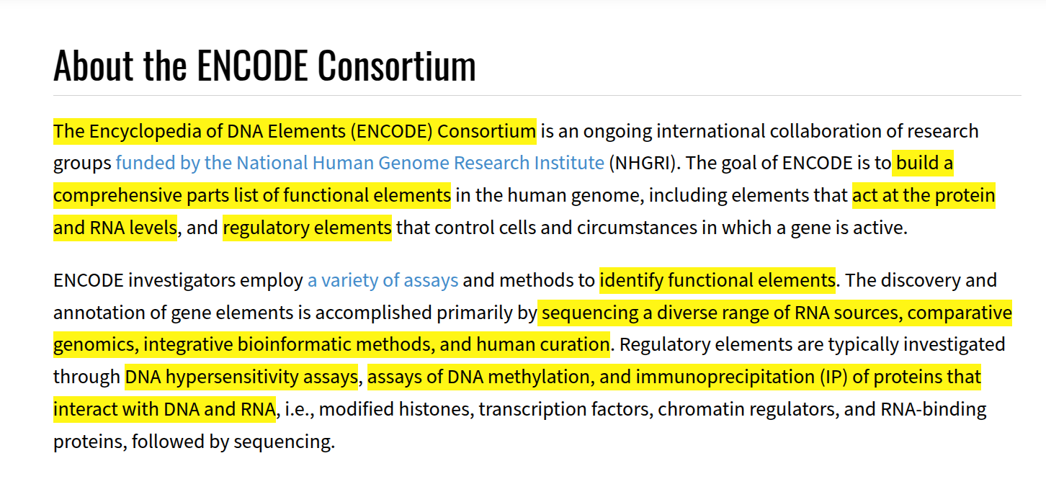
Introduction
Overview about ENCODE Consortium
https://www.encodeproject.org/

Slide 3
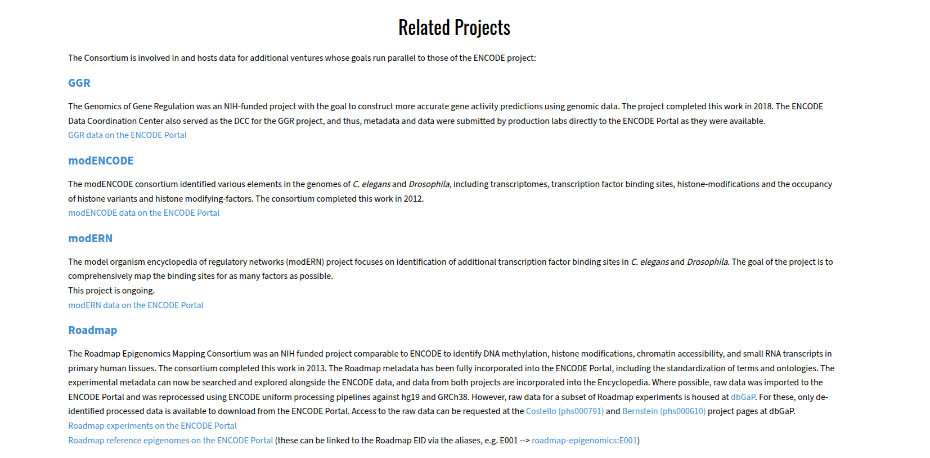
Introduction
https://www.encodeproject.org/

Slide 4
Introduction
ENCODE Phase I (2003–2007): Focused on only ~1% of the human genome (~30 Mb).
ENCODE Phase II (2007–2012): Expanded analysis to cover the entire human genome and also the mouse genome (methods like ChIP-seq, DNase-seq, RNA-seq) - 80% of the genome is biochemically active. (The ENCODE Project Consortium, 2012)
ENCODE Phase III (2012–2020): Included more cell types, tissues, and new data types.
ENCODE Phase IV (2020–present): …
https://www.nature.com/immersive/d42859-020-00027-2/index.html

Slide 5
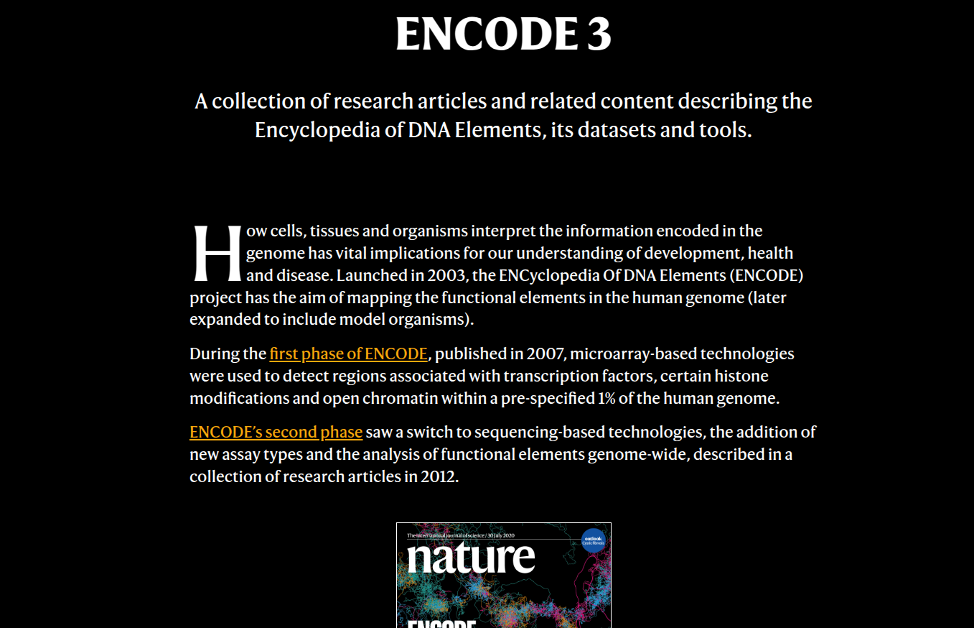
Introduction
https://www.nature.com/immersive/d42859-020-00027-2/index.html

Slide 6
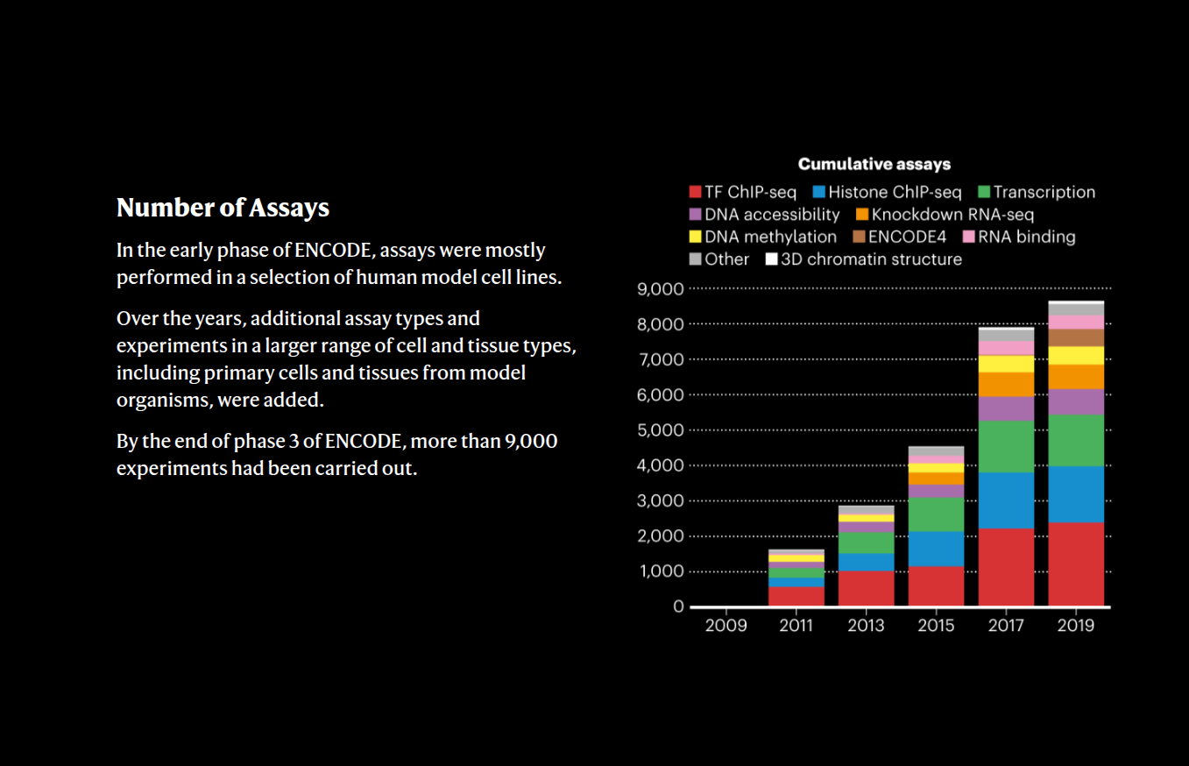
Introduction
https://www.nature.com/immersive/d42859-020-00027-2/index.html

Slide 7
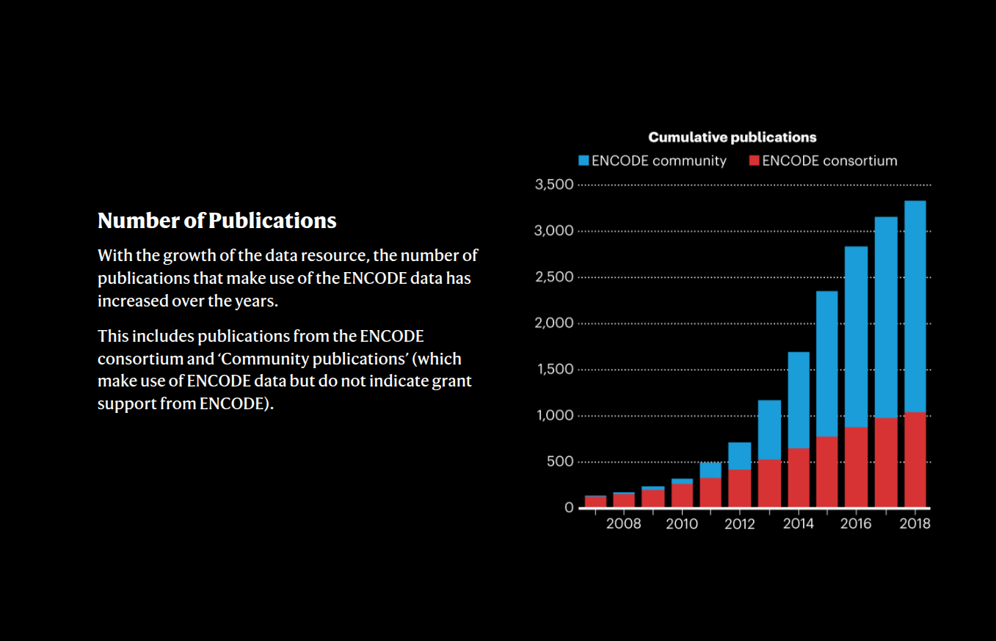
Introduction
https://www.nature.com/immersive/d42859-020-00027-2/index.html

Slide 8
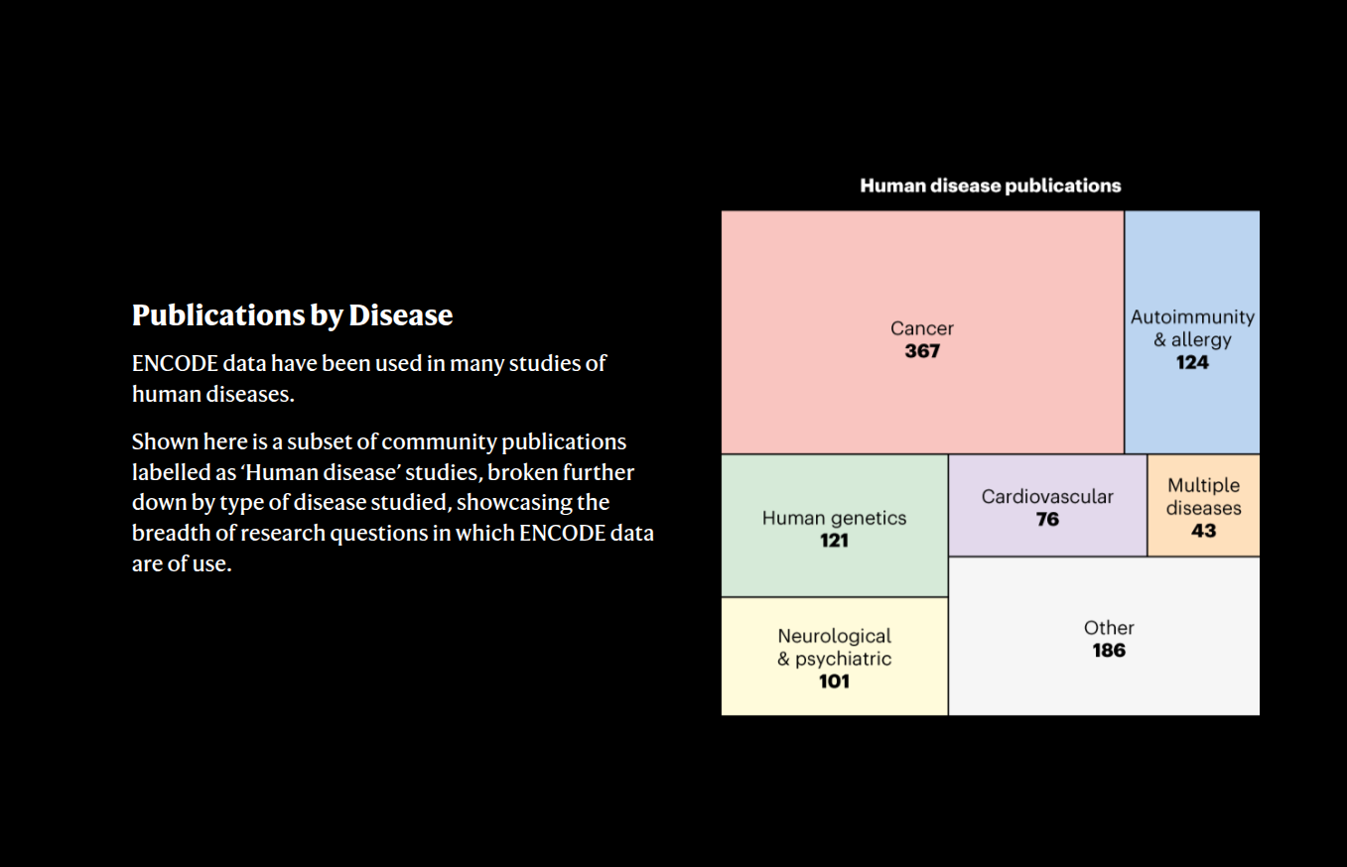
Introduction
https://www.nature.com/immersive/d42859-020-00027-2/index.html

Slide 9
Introduction
Key words
Map regulatory elements
How genes are controlled
Non-coding functional elements
Open-access data
https://www.encodeproject.org/

Slide 10
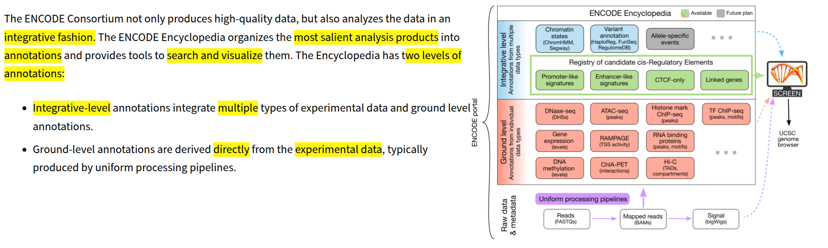
2. Searching
https://www.encodeproject.org/

Slide 11
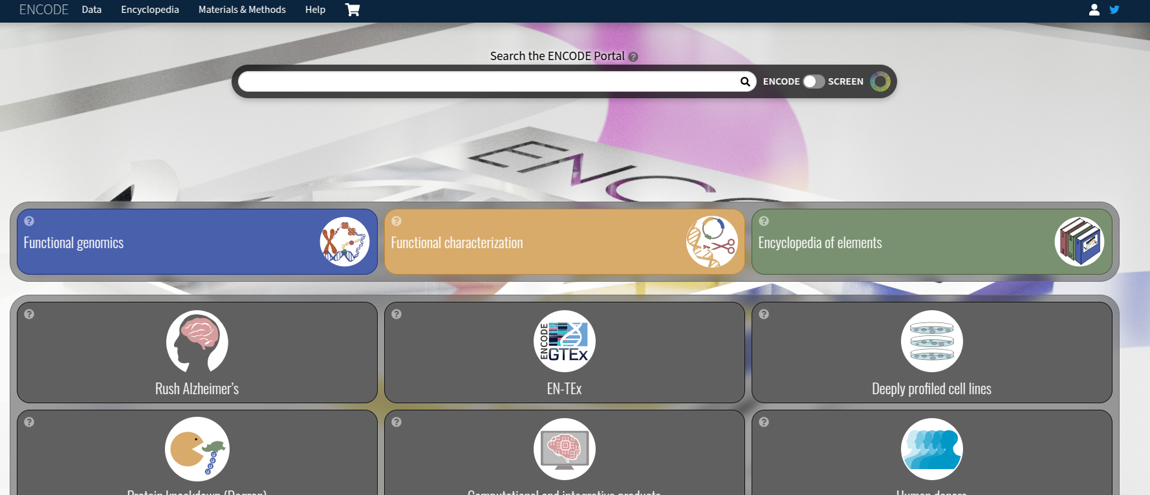
2. Searching
ENCODE portal
https://www.encodeproject.org/

Slide 12
2. Searching
Key words
Experiment type (e.g., ChIP-seq, RNA-seq)
Target (e.g., H3K27ac, CTCF)
Organism (human/mouse)
Biosample (e.g., K562, H1-hESC)
https://www.encodeproject.org/

Slide 13
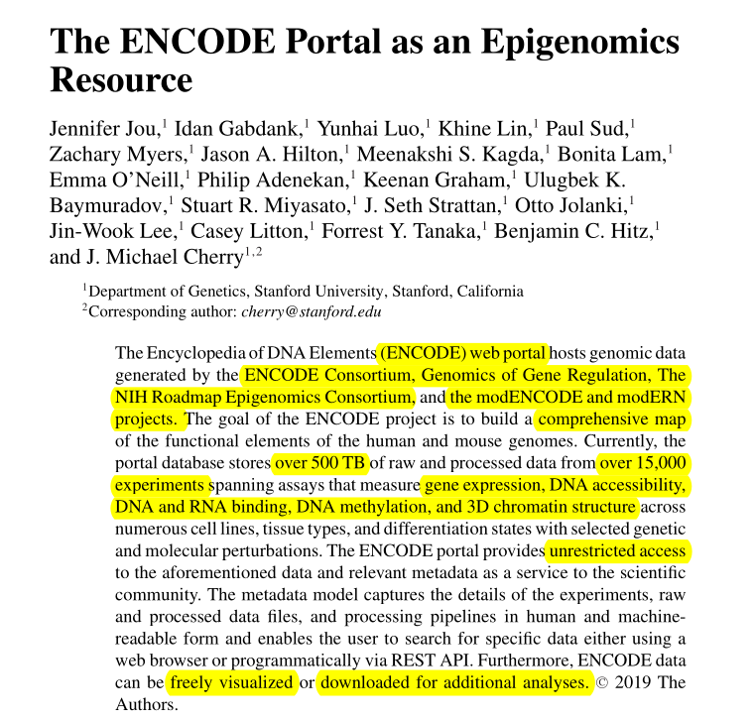
2. Searching
Jennifer Jou (2019)

Slide 14
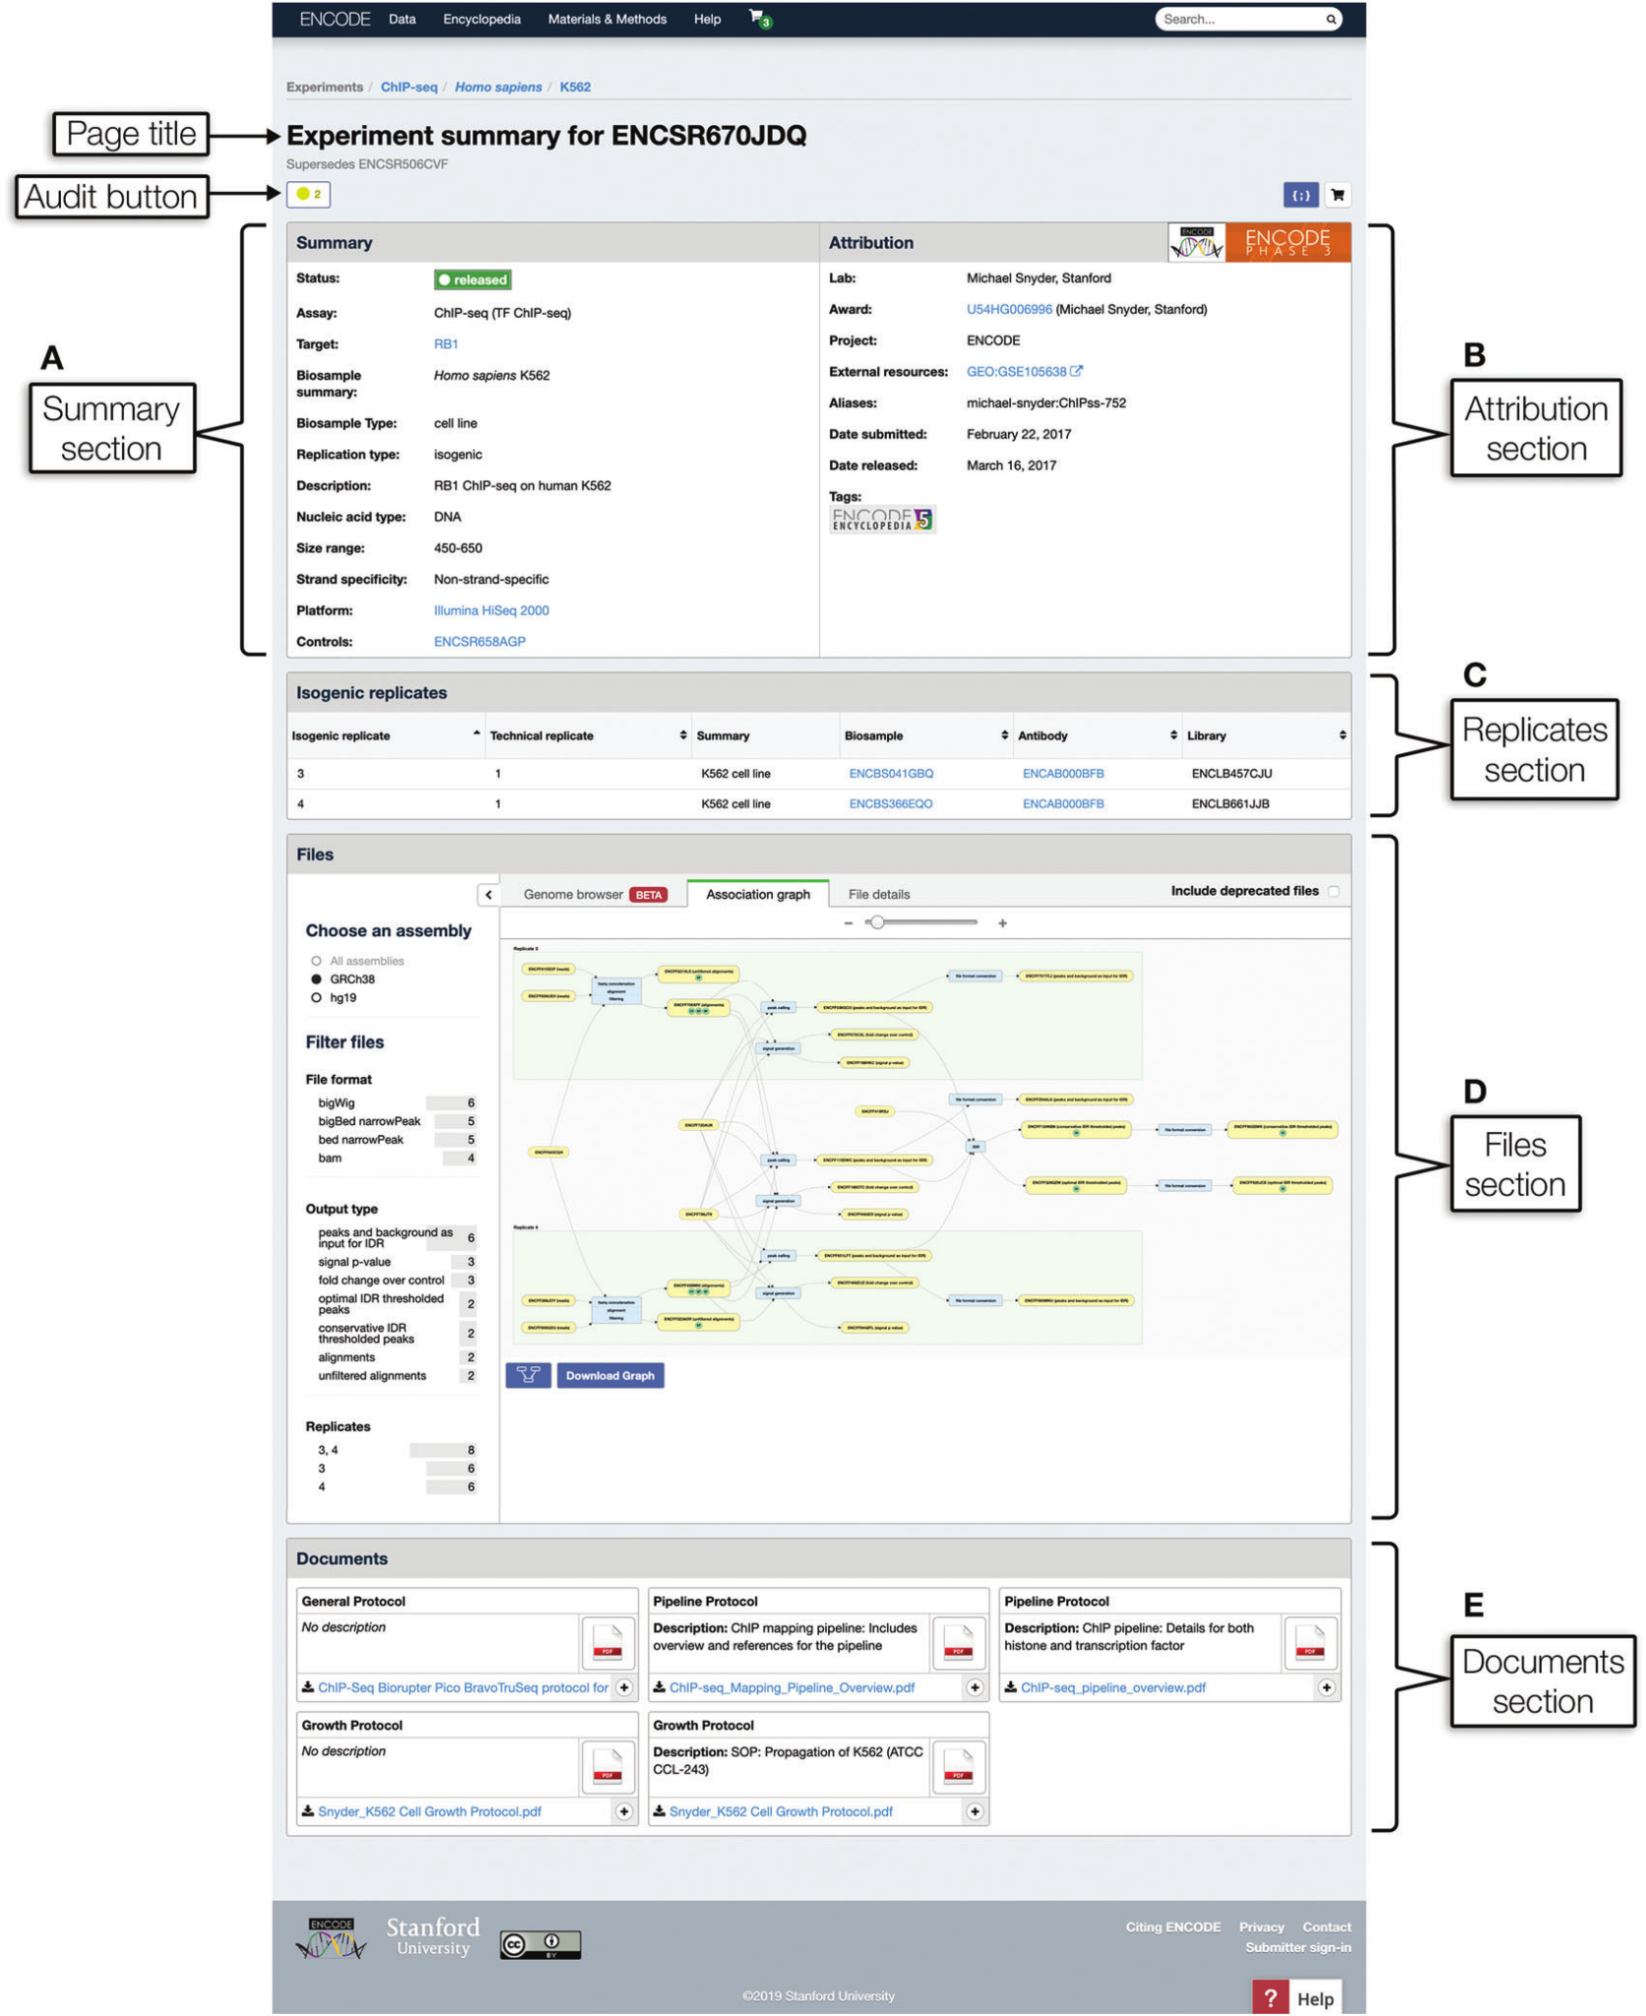
2. Searching
Jennifer Jou (2019)

Slide 15
2. Searching
📝 Exercise: Visualize CD47 Gene Using UCSC Genome Browser
Objective:
Visualize the CD47 gene and its associated epigenetic features (e.g., histone modifications, chromatin accessibility).
Explore different annotations from the ENCODE database.
Analyze potential regulatory elements such as promoters and enhancers.
Jennifer Jou (2019)

